Slide 1
The Processor and Buses
LO:
Computer Architecture

Slide 2
The Processor and Buses
LO:
Specification Point
3.7.1.1 Internal hardware components of a computer
3.7.3.1 The processor and its components
3.7.3.6 Factors affecting processor performance

Slide 3
The Processor and Buses
LO:
Prep Check
Notes:
Learn definitions: Processor, Bus, System Bus (Data, Address and Control), Clock, RAM, ROM, Volatile, Non-Volatile, BIOS, Main Memory, Memory addresses, I/O controller, microprocessor

Slide 4
Introduction to Computer Architecture
LO:
Buses
The System bus is the collective name given to the following three buses:
Data
Address
Control
What is sent along the data bus?
What is sent along the address bus?
What is sent along the control bus?

Slide 5
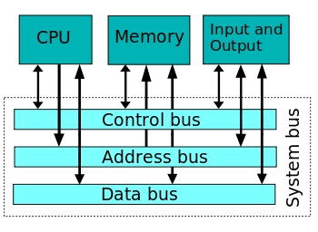
Introduction to Computer Architecture
LO:
Buses and the Three Box Model

Slide 6
Introduction to Computer Architecture
LO:
Data Bus
The instructions and data that comprise a computer program pass back and forth between the processor and memory as the program is run.
The data bus carries the data both to and from memory and to and from the I/O controllers, that is, they are bi-directional or two-way.
The instructions and data held in memory will vary in size.
Each memory cell will have a width measured in bits.
For example, it may have a width of 32 bits.

Slide 7
Introduction to Computer Architecture
LO:
Data Bus
32 and 64 bit PCs are currently the norm
They have data buses that are either 32 or 64 bits ‘wide’
The wider the data, the more data that can be transferred to the processor from Main Memory at one time

Slide 8
Introduction to Computer Architecture
LO:
Word Length
This is a term used to describe the number of bits that a processor is designed to accept/send over the data and address bus
E.g. 32 or 64
This is a 16 bit binary word. It could be data, or an instruction
0011 0100 1100 1010

Slide 9
Introduction to Computer Architecture
LO:
Address Bus
The address bus only goes in one direction – from the processor into memory.
All the instructions and data that a processor needs to carry out a task are stored in memory. Every memory location has an address.
The processor carries out the instructions one after the other.
The address bus is used by the processor and carries the memory address of the next instruction or data item.
The address bus therefore is used to access anything that is stored in memory, not just instructions.

Slide 10
Introduction to Computer Architecture
LO:
Address Bus
An address bus that is 8 bits wide could access how many memory locations in a hard disk?
2⁸ → 256
What is the advantage of having an address bus of 64 bits, over an address bus of 32 bits?
You can address twice as many memory locations which means you can store twice as much data in main memory

Slide 11
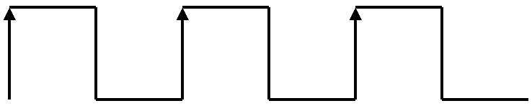
Introduction to Computer Architecture
LO:
The System Clock
A signal used to synchronise components and signals inside the processor
Measured in Hertz (Hz), which is the number of clock cycles per second.
1 Hz = 1 clock cycle per second
1 KHz = 1,000 clock cycles per second
1 MHz = 1,000,000 clock cycles per second
1 GHz = 1,000,000,000 clock cycles per second
1
0
Additional reading:
http://www.pcguide.com/ref/cpu/arch/extClocks-c.html

Slide 12
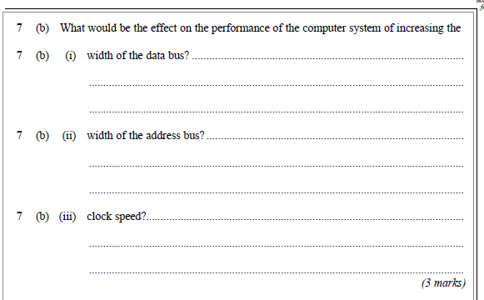
Introduction to Computer Architecture
LO:
Exam Question
Write the question and your answers in your book.

Slide 13
Introduction to Computer Architecture
LO:
Control Bus
The control bus is a bi-directional bus that sends control signals to the registers, the data and address buses.
There is a lot of data flowing around the processor, between the processor and memory, and between the processor and the input and output controllers.
Data buses are sending data to and from memory while address buses send only to memory.
The job of the data on the control bus therefore is to ensure that the correct data is travelling to the right place at the right time.
This involves the synchronisation of signals and the control of access to the data and address buses which are being shared by a number of devices.

Slide 14
Introduction to Computer Architecture
LO:
Control Bus Signals
Clock Signal: timing
Reset Signal: to initialise components
Memory Read: states that the memory location in use is being Read from
Memory Write: states that the memory location in use is being Written to
I/O: indicates when the CPU wishes to use an I/O Controller

Slide 15
Introduction to Computer Architecture
LO:
Input/Output (I/O) Controllers
In addition to the direct link between the processor and main memory, the processor will also receive and send instructions and data to the various input and output devices connected to the computer.
Basic I/O devices would be the keyboard, monitor, mouse and printer though modern computer systems would typically include several other devices.
A key feature of an I/O controller is that it will translate signals from the device into the format required by the processor.
The I/O controller is used to buffer data being sent between the processor and the device

Slide 16
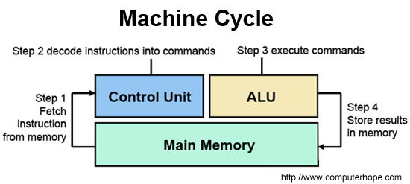
Introduction to Computer Architecture
LO:
Control Unit
This directs the operation of the processor
Controls the timing/order of instructions to be executed
Ensures the correct data is place on to the control, data and addresses buses at the correct time

Slide 17
Introduction to Computer Architecture
LO:
Prep
Moore’s Law broadly states that processor performance will double every two years. He made this prediction in 1965. Is it true and do you think it will continue to be true?
Some people believe that the next big advance in microprocessor technology is when we move on from the silicon chip. What are the limitations of the silicon chip and what might replace it in the future?

Slide 18












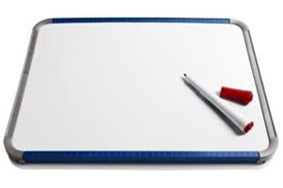


Key words:
Noted clearly
Topic specific vocabulary wherever necessary
Icon for extension activity if appropriate
Icon same colour as dept ex book
You might want to develop subject specific icons

